Slide 1
Match day
A format for a best practice match day

Slide 2
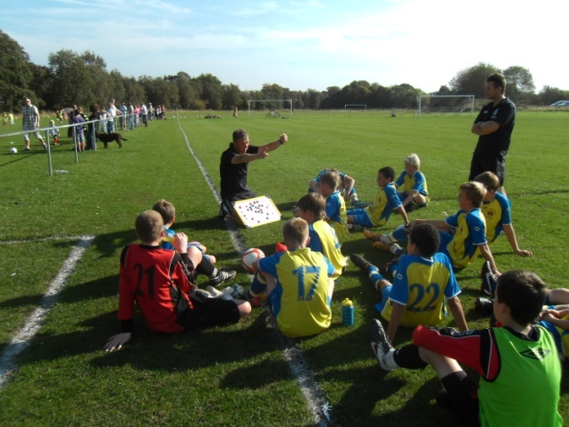
Match Day
Consider:
What do you in training that prepares you & your players for match-day?
How does the match-day run from the moment the players arrive until they leave (think about the dressing room, setting up the pitch, briefing the players, warming up, substitutions, intervals and post match)?
What are your players trying to get better at and how do you/they know how they’re getting on?

Slide 3
Timing The Event
Kick off at 10:30am
9:45am Team line ups, player responsibilities (equipment/water etc.), playing position cards + set pieces (11-a-side) up in dressing room
9:55am Player briefing – Team challenges + individual challenges
10:05am Pitch-side – Warm up – age appropriate & match preparatory
10:25am Final reminders
A Match-day Philosophy?
Try to play ‘football’
Try to improve and work at my challenge(s)
Play within the laws & demonstrate discipline
Try to win the game….but not at the expense of 1-3

Slide 4

Team Challenge – When to Keep it, When to Risk it
Theo
Phil
Try to work out when to pass the ball & when to Run with the ball
Look for opportunities to RWTB up the wing
Gary
Scott
Try to look for passes into the forwards feet
Can you push the defence up with the ball
Wayne
Steve
Joe
Try to find spaces in behind defence
When can you help out in attack
Try to work out when to come off your line
John
Gareth
Try to mark goal-side of the striker
Look for opportunities to switch play
Ashley
Ashley
When to use tricks & skills to beat a player
Try to link up passes into midfield

Slide 5
Player position cards
Wide players
Position No 2 & 3
In Possession
Join in and support the attack when play is on your side.
Can you overlap and get beyond the player in possession.
Anticipate the cm switching the play
Out of possession
Provide cover and support to the centre backs when play is on the opposite side of the pitch.
Defend aggressively.
Apply pressure on the ball if 1st defender

Slide 6
Player position cards
High Strikers
Position No 7 & 11
In Possession
Be direct and use your pace.
Rotate position with other strikers.
Play on the defenders shoulder.
Make angled runs.
Out of possession
Split defenders at goal kicks and throws
Get behind the ball and make opponents play long
Know when to pressurise

Slide 7
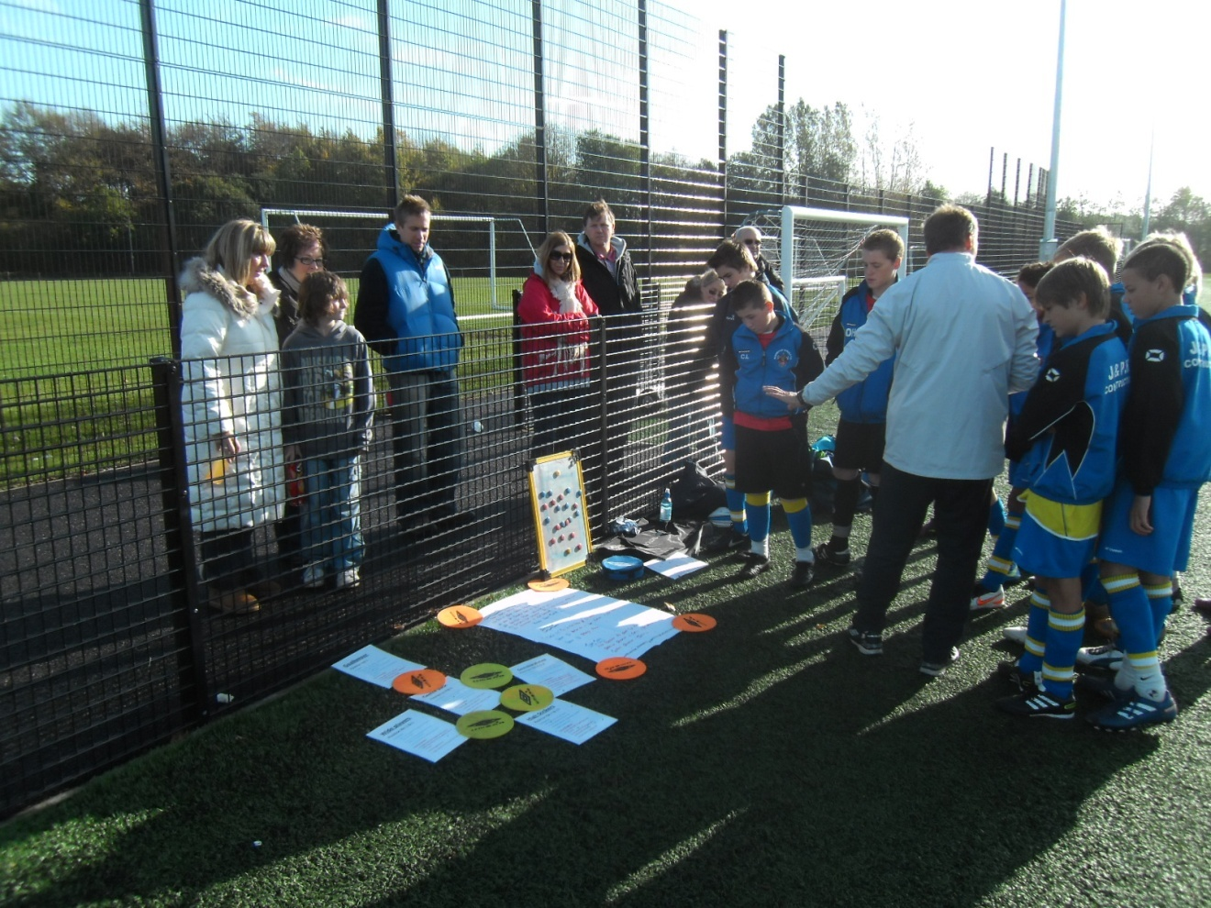
Player position cards
Parents need to be aware of the players jobs
Include them in the process
Deliver your team talk in ear shot and view of the parents

Slide 8
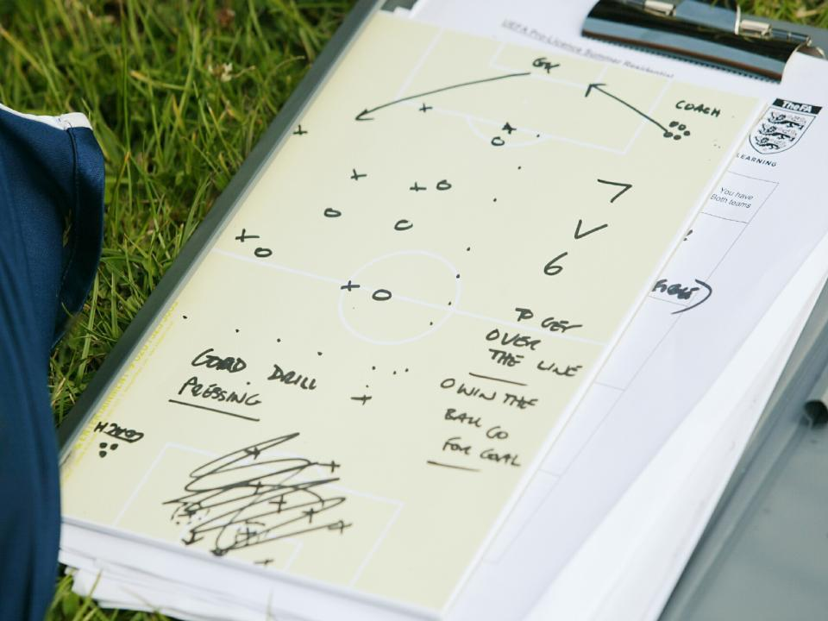
Team Challenges
Discuss 3 areas prior to the game
One when in Possession
One when out of possession
One can be more general
Can they be measured.....this is your start point at half time...be specific...

Slide 9
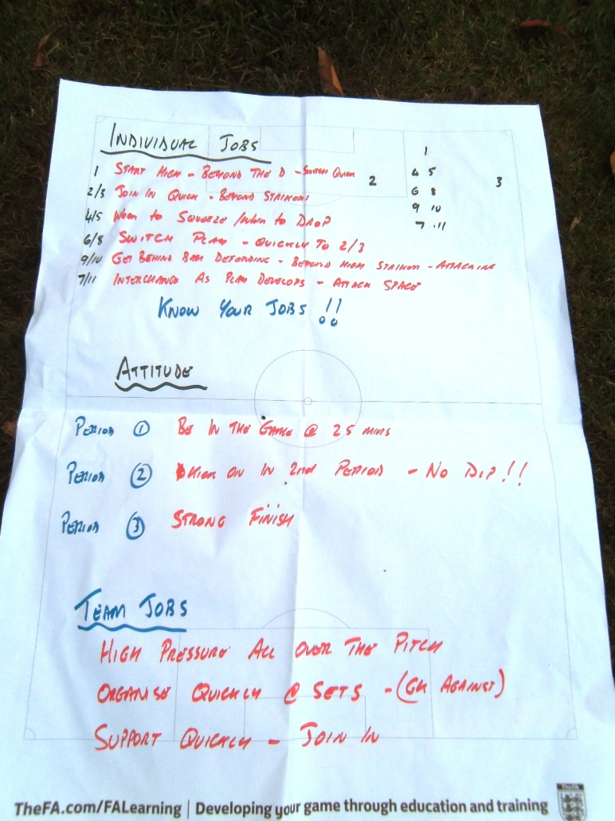
Quarter Breaks and Half Time
Allow time for individual reflection.
Refer back to your team goals
Refer back to individual challenges
Can the players lead the discussion
Do they understand what is happening.
3 stars and a wish

Slide 10
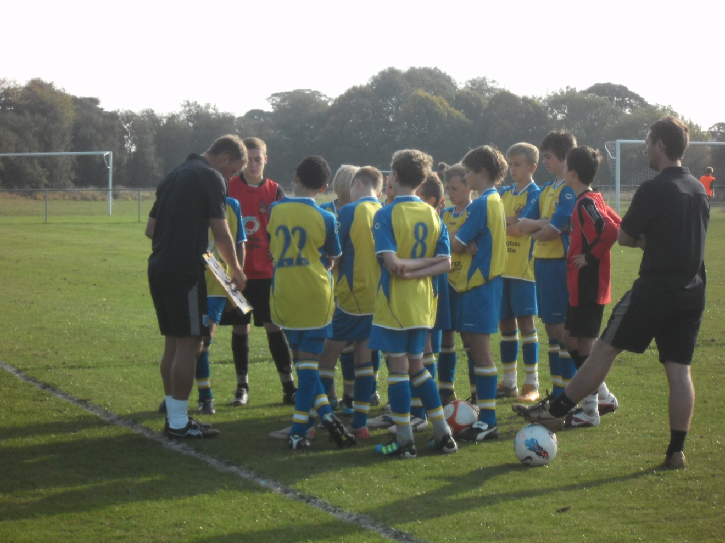
Post game discussion
Keep this brief...allow players to reflect
Stick to 3 points
Re focus on the individual and team challenges
Revisit at the next time you meet
Allow for the dust to settle.....

Slide 11

Feedback
Individual players cards
Match reflection sheets
Training reflection sheets
Working to 3 month individual goals linking into 4 phases in the year.

Slide 12
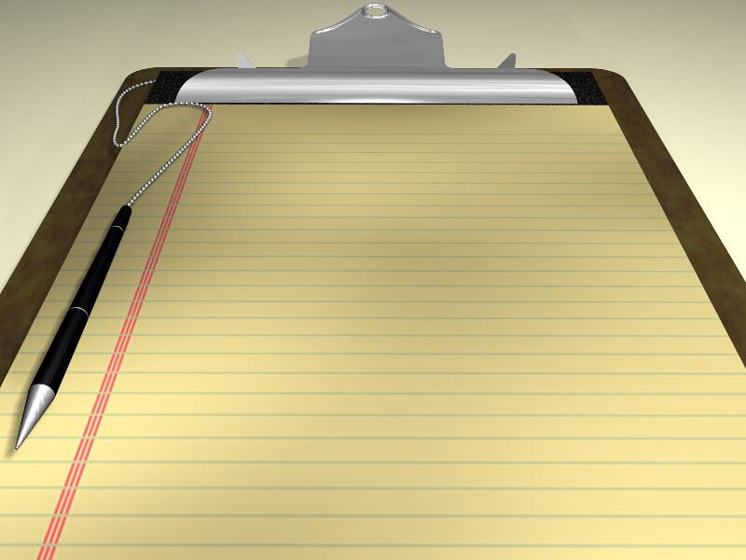
Key messages.......top 10
Identify what your players want to achieve
Understand how that you can best help them
Formulate a long term plan
Communicate your message to the players and parents
Play in a variety of game formats
Use matches as a learning opportunity
Provide clear roles and responsibilities
Share your thoughts with the parents
Provide clear individual feedback to the players
Concentrate on the process not the outcome or score
Good Luck !!
Notes:
Check Understanding
Emphasise the 3 r’s
Move to planning of the practical

